Slide 1
CAN FD Frame Format
Shyam Bhat
VicharaVandana

Slide 2
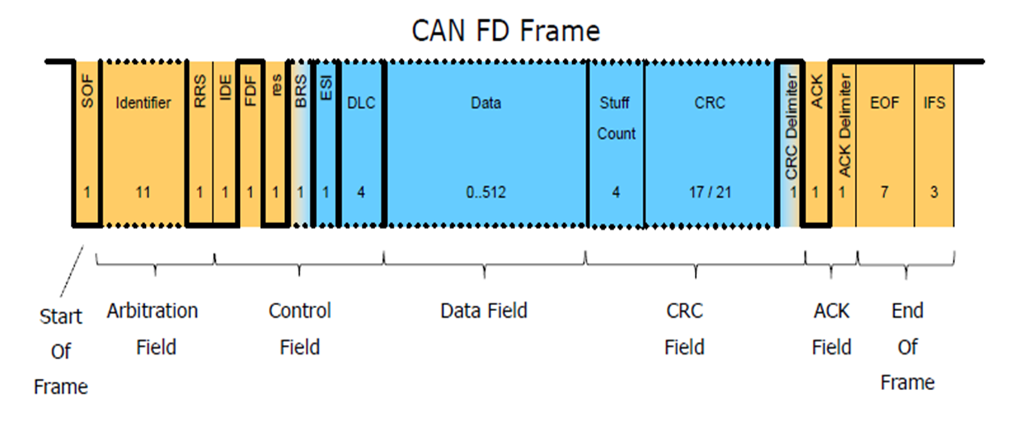
Data Frame Format

Slide 3
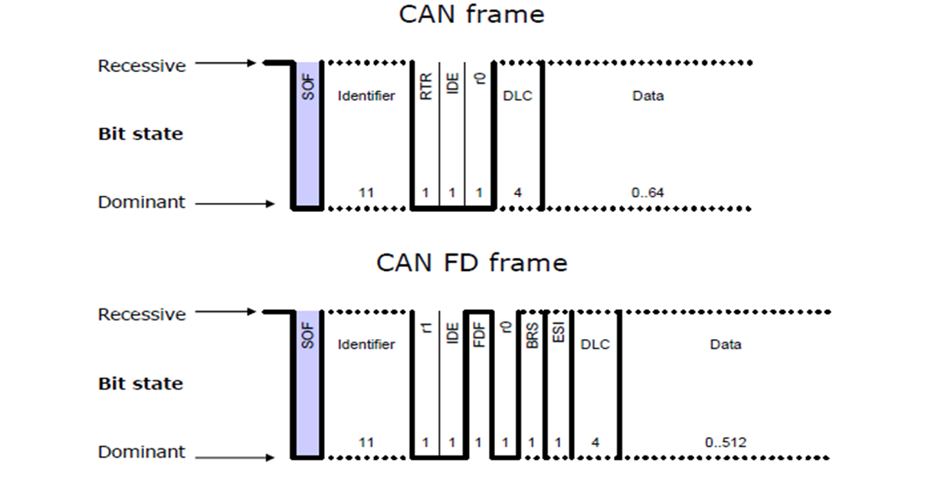
Start of Frame
CAN and CAN FD use the same SOF –a single “dominant” bit

Slide 4
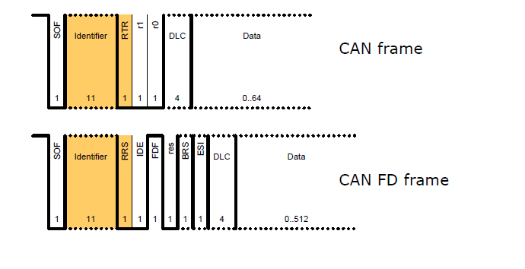
Arbitration Field
Little difference between CAN and CAN FD arbitration fields
Both share the same addressing for Standard and Extended formats
CAN FD removes the RTR bit and maintains an always dominant RRS bit

Slide 5

Control Field
CAN and CAN FD share the following bits:
- IDE , res and DLC bits.
CAN FD adds the following bits to the control field:
- FDF (FD Frame)
- BRS (Bit rate switch)
- ESI (Error state indicate)

Slide 6
CAN-FD Frame Control Field
FDF (FD Frame) :
- Determines CAN FD (recessive)
- in classical CAN this bit is not present
BRS (Bit rate switch) :
- Clock rate switches when BRS is recessive
ESI –Error State Indicator (error active/pasive)

Slide 7
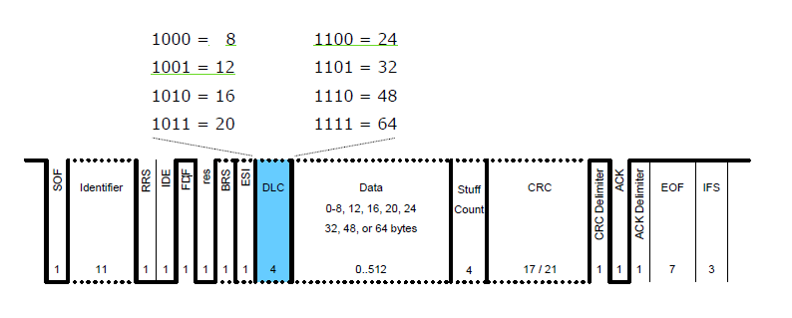
Control Field: DLC
4 bits are used for both formats (CAN and CAN-FD)
For DLC ≥ 8, CAN FD uses the following DLCs:

Slide 8
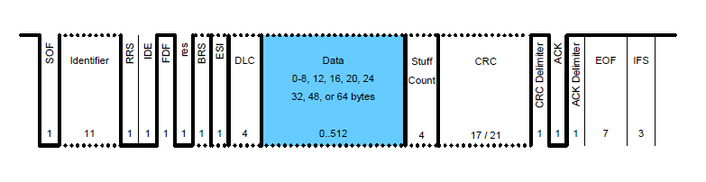
Data Field :
0-8 bytes in CAN
0-8, 12, 16, 20, 24, 32, 48, or 64 bytes in CAN FD

Slide 9
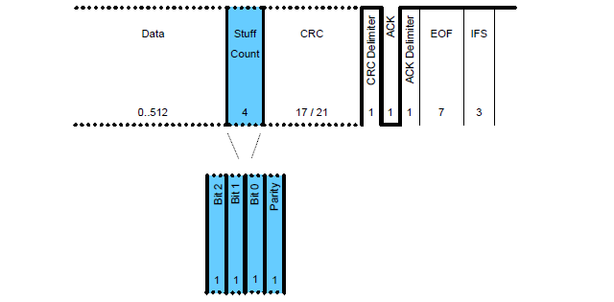
CRC Field: Stuff Count
How many Stuff bits are there in the bit stream are provided in the Frame after Data field.

Slide 10
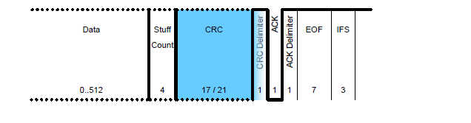
CRC Field: CRC Sequence
Size of CRC differs based on CAN/CAN FD and length of DLC
15 bits for CAN
17 bits for CAN FD where DLC ≤ 16 bytes
21 bits for CAN FD where DLC > 16 bytes

Slide 11
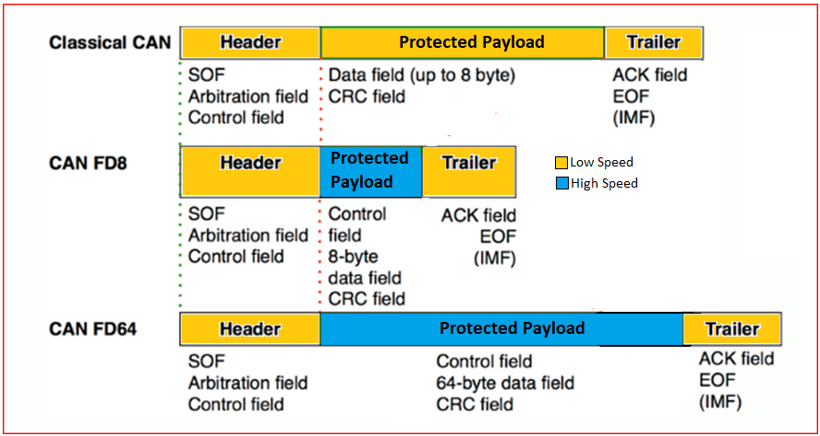
CAN-FD → Dual Speed and Higher Payload

Slide 12


